Slide 1

Mobile Testing ONLINE PART 1
Created by Ivette Doss

Slide 2
Why you need this class?
This class is consolidation of real Internships/Jobs Interview Questions that were submitted by the Students of Portnov Computer School within 2011-2012 school year.
This class is part of liveable QA Student Social Network established by Mikhail Portnov: Graduated Students shared their Interview’s experiences with the current Students to help them successfully pass Internship or Job Interviews.
Therefore, the Class will be always subject of change, reflection and adjustment of the new information from the Mobile Field.

Slide 3

Groups of Questions to be discuss:
Mobile OS/Platform Fundamental
How well you know Mobile Devices
Mobile/Software literacy
Specific of Mobile Testing
Mobile Testing tools
Security of Mobile Devices
The future Trends in Mobile World

Slide 4

Learning Objective Today: cover 17 questions
Section 1: Mobile OS/Platforms Fundamental –
17 questions

Slide 5

To use the presentation effectively:
The helpful online Resources
The information you should remember
Last Minute Update
Q
Interview Question
U
The information you need to find
by yourself and learn

Slide 6

Definitions that you should know by now:
Platform
Operating System
Framework
Kernel
Source-machine-logic code
Operators/Carriers/Providers
Makers/Manufactures
GSM, CDMA, WiMax, and LTE
Tethering
Fragmentation
API
SDK
Rooted vs. un-rooted phone
Locked vs. un-locked phone
Jailbreak

Slide 7


Mobile OS/Platforms Fundamentals
Section 1

Slide 8
List of Interview Questions: Section 1
1. What mobile platforms you are familiar with?
2. What do you know about Android OS/Platform?
3. What is a most common Android Version?
4.A/B What are the latest Android/iOS versions?
5.A/B What are the extensions of Android/iOS applications?
6. A/B What Android/iOS Browsers do you know?
7. A/B What Android/iOS developing Tools do you know?
8.A/B What Android/iOS Testing Tools do you know?
9. What do you know about SDK?
10. What do you know about iOS?
11. Describe Android OS vs. iOS
12. Describe Android vs. iPhone devices
17 Questions

Slide 9

1. What mobile platforms are you familiar with?
Android
iOS
BlackBerry RIM
Windows Phone
Tizen Linux
Linux OS
BREW
Symbian OS
Palm webOS

Slide 10
List of Interview Questions: Section 1
1. What mobile platforms you are familiar with?
2. What do you know about Android OS/Platform?
3. What is a most common Android Version?
4.A/B What are the latest Android/iOS versions?
5.A/B What are the extensions of Android/iOS applications?
6. A/B What Android/iOS Browsers do you know?
7. A/B What Android/iOS developing Tools do you know?
8.A/B What Android/iOS Testing Tools do you know?
9. What do you know about SDK?
10. What do you know about iOS?
11. Describe Android OS vs. iOS
12. Describe Android vs. iPhone devices

Slide 11

2. What do you know about Android OS? 1
The Android History starts at October 22nd, 2008, when the T-Mobile G1 launched in the United States.
Android is a software stack for mobile devices that includes an operating system, middleware and key applications. Android is software platform for mobile devices based on the Linux Operating System that developed by Google and the Open Handset Alliance (OHA).

Slide 12

Architecture of Android 2
Applications
Home
Phone
Application Framework
Package Manager
Telephony Manager
Libraries and Android Runtime
Android Runtime consist:
Contacts
Browser
Content Providers
Location System
Notification System
Dalvik Virtual Machine
Linux Kernel
Drivers Package
Power management
Hardware
Core Libraries
Libraries:
Media SurfaceM FreeType
Open GL\ SSL SQLite
WebKit SGL libc
OS
http://www.mindcracker.com/Story/1076/architecture-of-android

Slide 13
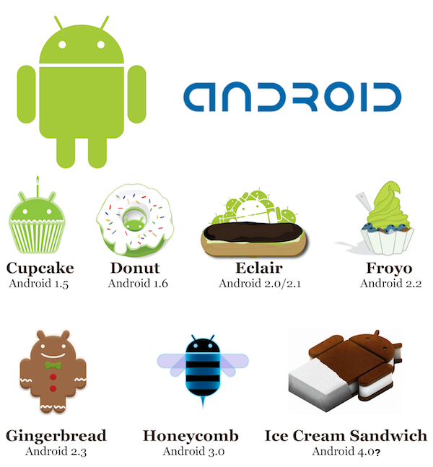

Android Versions History – NEED to KNOW 3
June 26, 2012
04-2009
09-2009
11-2009
05-2010
Jelly Bean
Android 4.1
12-2010
02-2011
10-2011

Slide 14
List of Interview Questions: Section 1
1. What mobile platforms you are familiar with?
2. What do you know about Android OS/Platform?
3. What is a most common Android Version?
4.A/B What are the latest Android/iOS versions?
5.A/B What are the extensions of Android/iOS applications?
6. A/B What Android/iOS Browsers do you know?
7. A/B What Android/iOS developing Tools do you know?
8.A/B What Android/iOS Testing Tools do you know?
9. What do you know about SDK?
10. What do you know about iOS?
11. Describe Android OS vs. iOS
12. Describe Android vs.iPhone devices

Slide 15
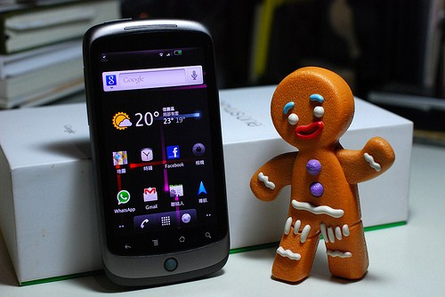
Most common Android Version:
2.3.x Gingerbread | 12-2010 | 64.0%
http://www.theverge.com/2011/12/7/2585779/android-history

Slide 16
Good to know: Upgrade concept
Android
iPhone
Only specific Phones Models and Brands will be upgraded.
IF you are chosen one – be patient, soon or later your Phone will be upgraded via FOTA (firmware over the air) automatically.
Do it hard way: follow your handset manufacturer and wireless carrier on Twitter. They will usually announce dates so you can be on the lookout and update manually.
Getting to the root of the matter: “root” your phone and download a custom ROM of Android 4 once it becomes available.
Apple provides updates to the iOS operating system, for the iPhone, iPad and iPod Touch, through iTunes and since iOS version 5.0 also through firmware over the air (FOTA).
Simply Go to Settings > General > Software Update.
Since version 5.0, a USB connection to iTunes is no longer needed to activate iOS devices; data synchronization happens automatically and wirelessly through Apple's new iCloud service.
http://www.roms4droid.com/
http://www.androidauthority.com/android-4-ics-update-device-list-66785/

Slide 17
List of Interview Questions: Section 1
1. What mobile platforms you are familiar with?
2. What do you know about Android OS?
3. What is a most common Android Version?
4.A/B What are the latest Android/iOS versions?
5.A/B What are the extensions of Android/iOS applications?
6. A/B What Android/iOS Browsers do you know?
7. A/B What Android/iOS developing Tools do you know?
8.A/B What Android/iOS Testing Tools do you know?
9. What do you know about SDK?
10. What do you know about iOS?
11. Describe Android OS vs. iOS
12. Describe Android vs. iPhone devices

Slide 18

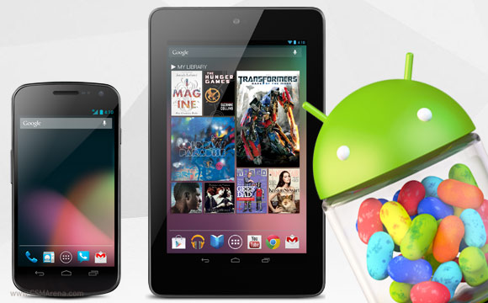


4A. What is the Latest Android version?
JellyBean 4.1
Project Butter has brought smoother and faster feeling user interface
Improved notification center with expandable and actionable notifications
Improved keyboard behavior with word prediction
Offline Voice recognition and typing
Google Voice search is more intelligent than ever
Google Now adds automatic information feeds to your device (weather, traffic, sports, etc)
Bi-Directional text and additional language support
Truly high-resolution contact photos
USB audio output and HDMI multichannel audio output
http://www.youtube.com/watch?v=afNRAOg5jUk

Slide 19

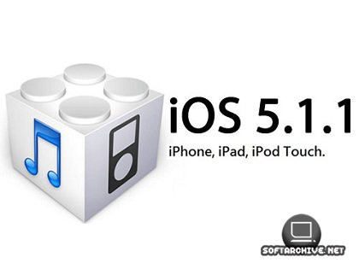
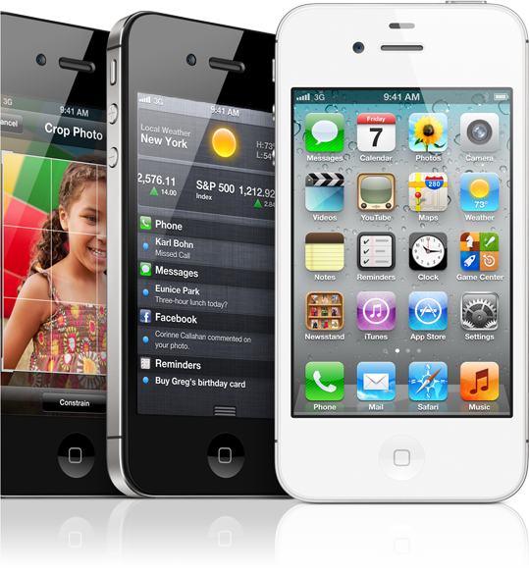
4B. What is the latest iOS version?
The latest production version of iOS is 5.1.1 that currently run on upgraded iPhone 3GS, 4,4S, iPod Touch 4, iPad3, and Apple TV 3 (originally released March,2012)
Specifically, for iPhone 4S the current version is 5.1.1 was released in May, 2012.
In June 2012, iOS 6 is released as a Beta version for Developers. It planned to be release for the end users on October 22, 2012 .

Slide 20
List of Interview Questions: Section 1
1. What mobile platforms you are familiar with?
2. What do you know about Android OS?
3. What is a most common Android Version?
4. A/B What are the latest Android/iOS versions?
5. A/B What are the extensions of Android/iOS applications?
6. A/B What Android/iOS Browsers do you know?
7. A/B What Android/iOS developing Tools do you know?
8. A/B What Android/iOS Testing Tools do you know?
9. What do you know about SDK?
10. What do you know about iOS?
11. Describe Android OS vs. iOS
12. Describe Android vs. iPhone devices

Slide 21

5A. What is the file extensions for Android?
.apk - application package file (APK) is the file format used to distribute and install application software and middleware onto Google's Android operating system.
.dex -Android programs are compiled into .dex (Dalvik Executable) files, which are in turn zipped into a single .apk file on the device.

Slide 22
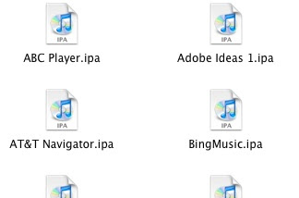
5B. What is the iPhone file extensions?
An .ipa file is an iPhone application archive file.
It is usually encrypted with Apple's FairPlay DRM technology.
Each .ipa file is compressed with a binary for the ARM architecture and can only be installed on an iPhone, iPod Touch, or iPad.
Files with the .ipa extension can be uncompressed by changing the extension to .zip and unzipping.
TIP: .ipa files cannot be installed on the iPhone Simulator because they do not contain a binary for the x86 architecture.
To run applications on the simulator, we need to open original project files using the Xcode SDK.
Apple Firmware files have an .ipsw extension
The .MDBACKUP file type is primarily associated with 'IPhone' by Apple Inc.. An iTunes backup of the iPhone is stored in a backup folder in ~/Library/Application Support/MobileSync/Backup.
Each subdirectory contains the backup from a different device. MDBACKUP files, found in the device directories, are property lists and are created in a compressed binary format.

Slide 23
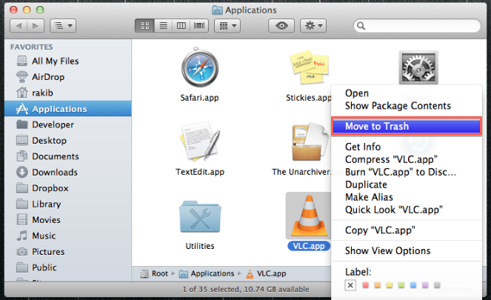
.app extension – Good to know
APP is an abbreviation for application.
The filename extension .app means application in Windows (via AppWave), iOS, Symbian OS, SkyOS, GNUstep and Mac OS X.
For Mac OS X and GNUstep .app file is actually a folder containing binaries and supporting files.
On Windows, AppWave supplies the support to run .app Windows binaries.
App may also refer to a lightweight application tailored to a device's form factor and input-output interfaces (keypad, touch pad, remote control, display, etc).

Slide 24
List of Interview Questions: Section 1
1. What mobile platforms you are familiar with?
2. What do you know about Android OS?
3. What is a most common Android Version?
4.A/B What are the latest Android/iOS versions?
5.A/B What are the extensions of Android/iOS applications?
6. A/B What Android/iOS Browsers do you know?
7. A/B What Android/iOS developing Tools do you know?
8.A/B What Android/iOS Testing Tools do you know?
9. What do you know about SDK?
10. What do you know about iOS?
11. Describe Android OS vs. iOS
12. Describe Android vs. iPhone devices

Slide 25


Modern Web Browser: WebKit
WebKit is a layout engine designed to allow web browsers to render web pages.
WebKit powers the Apple Safari and Google Chrome browsers.
It is also used as the basis for the experimental browser included with the Amazon Kindle ebook reader, as well as the default browser in the iOS, Android, BlackBerry Tablet OS and webOS mobile operating systems.
The WebKit engine provides a set of classes to display web content in windows, and implements browser features such as following links when clicked by the user, managing a back-forward list, and managing a history of pages recently visited.
It is most popular Layout engine in the world (36% of Market Share).
http://en.wikipedia.org/wiki/Mobile_browser
http://www.webkit.org/
http://en.wikipedia.org/wiki/List_of_web_browsers#WebKit-based

Slide 26

6A. What Android Browsers do you know?
Fennec (Mobile Firefox)
SkyFire
xScope
Google Chrome
June 28, 2012
Opera Mini 7
Opera
Dolphin
OverSkreen
Boat
Maxthon
http://techhamlet.com/2012/06/best-browser-apps-android-device/

Slide 27
6B. What iPhone Browsers do you know?
Opera Mini
Chrome
Atomic Web
Dolphin
Aquari
Private Web
Wide Web
Safari
Incognito
iBrowse2
http://lifehacker.com/5922808/lifehacker-faceoff-the-best-web-browsers-for-iphone-and-ipad

Slide 28
List of Interview Questions: Section 1
1. What mobile platforms you are familiar with?
2. What do you know about Android OS?
3. What is a most common Android Version?
4.A/B What are the latest Android/iOS versions?
5.A/B What are the extensions of Android/iOS applications?
6. A/B What Android/iOS Browsers do you know?
7. A/B What Android/iOS developing Tools do you know?
8.A/B What Android/iOS Testing Tools do you know?
9. What do you know about SDK?
10. What do you know about iOS?
11. Describe Android OS vs. iOS
12. Describe Android vs. iPhone devices

Slide 29

7A. What Android developing Tools do you know?
Google provides the Android Development Tools (ADT) to develop Android applications with Eclipse.
ADT is a set of components (plug-ins) which extend the Eclipse IDE with Android development capabilities.
From Developer’s perspective we should install ADK (Android Development Kit) to the PC and use Java programming language for development.
For a lower level programs, NDK (Native Development Kit) in C language should be used.
Connect Bot
App Manager
Bar Code Scanner
WordPress for Android
Webmaster’s HTML Editor Lite
JavaScript Reference
AndFTP
Joooid
HTML5 Reference
Color Pal
http://www.gizmocrazed.com/2012/02/android-apps-web-developers/

Slide 30
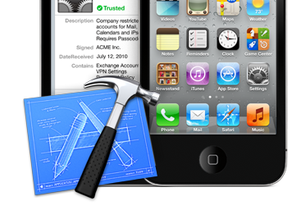
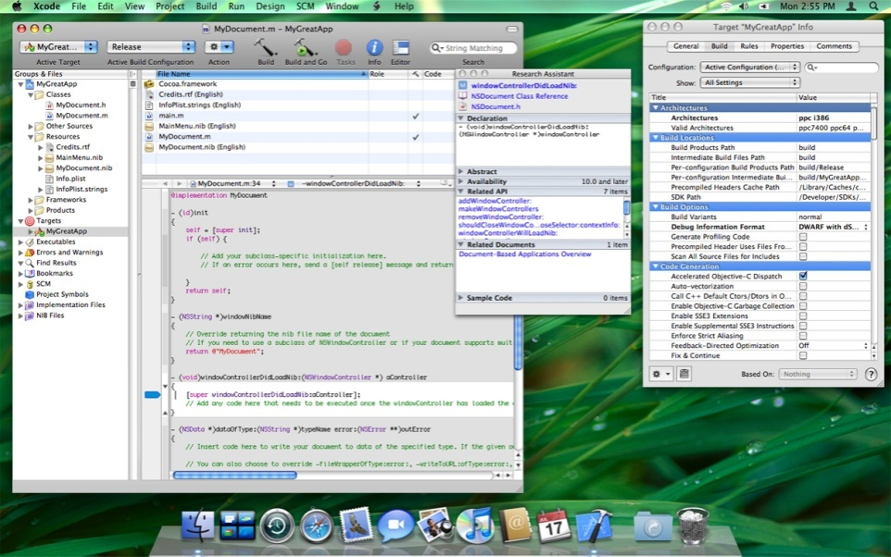
7B. What iOS developing tools do you know?
Xcode 4
This is complete IDE toolset for creating Mac, iPhone, and iPad apps includes the Xcode IDE, performance analysis tools, iOS Simulator, and the latest Mac OS X and iOS SDKs
http://www.techotopia.com/index.php/The_iOS_4_Architecture_and_SDK_Frameworks

Slide 31
List of Interview Questions: Section 1
1. What mobile platforms you are familiar with?
2. What do you know about Android OS?
3. What is a most common Android Version?
4.A/B What are the latest Android/iOS versions?
5.A/B What are the extensions of Android/iOS applications?
6. A/B What Android/iOS Browsers do you know?
7. A/B What Android/iOS developing Tools do you know?
8. A/B What Android/iOS Testing Tools do you know?
9. What do you know about SDK?
10. What do you know about iOS?
11. Describe Android OS vs. iOS
12. Describe Android vs. iPhone devices

Slide 32


8A. What Android’s Testing Tools do you know?
#1: Eclipse w/ADT
#2: The SDK and AVD Manager
#3: Android Debug Bridge
#4: Dalvik Debug Monitor Server
#5: The Android Emulator and Real Devices
#6: LogCat
#7: The Hierarchy Viewer
#8: Draw 9-Patch
#9: The Monkey Test Tools
#10: ProGuard
http://www.developer.com/ws/android/development-tools/10-must-have-android-tools-for-developers.html

Slide 33

8B. What iPhone Testing Tools do you know?
UIAutomation
FoneMonkey5
(Gorilla Logic)
Frank
Keep It Functional
(or KIF) on GitHub
iPhoney
iPad Peek
Telerik Test Studio
http://www.mobileapptesting.com/the-best-tools-for-mobile-app-testing/2011/08/
http://www.drdobbs.com/joltawards/jolt-awards-the-best-testing-tools/232901286?pgno=5

Slide 34
List of Interview Questions: Section 1
1. What mobile platforms you are familiar with?
2. What do you know about Android OS?
3. What is a most common Android Version?
4.A/B What are the latest Android/iOS versions?
5.A/B What are the extensions of Android/iOS applicationa?
6. A/B What Android/iOS Browsers do you know?
7. A/B What Android/iOS developing Tools do you know?
8. A/B What Android/iOS Testing Tools do you know?
9. What do you know about SDK?
10. What do you know about iOS?
11. Describe Android OS vs. iOS
12. Describe Android vs. iPhone devices

Slide 35
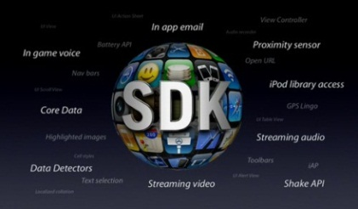


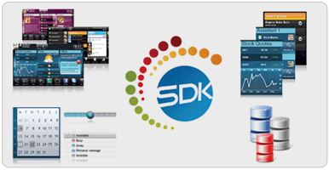
9. What do you know about SDK?
A software development kit (SDK or "devkit") is typically a set of software development tools that allows for the creation of applications for a certain software package, software framework, hardware platform, computer system, video game console, operating system, or similar platform.
Typically an SDK includes one or more APIs, programming tools, and documentation.
iPhone SDK:
http://www.morgana.ca/freedev.html
Android SDK:
http://developer.android.com/training/basics/firstapp/index.html
Windows Phone SDK:
http://msdn.microsoft.com/en-us/library/ff402523(v=vs.92).aspx

Slide 36
List of Interview Questions: Section 1
1. What mobile platforms you are familiar with?
2. What do you know about Android OS?
3. What is a most common Android Version?
4.A/B What are the latest Android/iOS versions?
5.A/B What are the extensions of Android/iOS applications?
6. A/B What Android/iOS Browsers do you know?
7. A/B What Android/iOS developing Tools do you know?
8. A/B What Android/iOS Testing Tools do you know?
9. What do you know about SDK?
10. What do you know about iOS?
11. Describe Android OS vs. iOS
12. Describe Android vs. iPhone devices

Slide 37
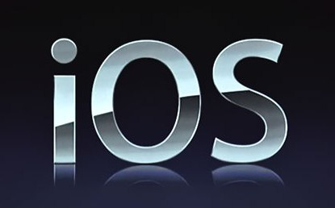
10. What do you know about iOS? 1

Slide 38
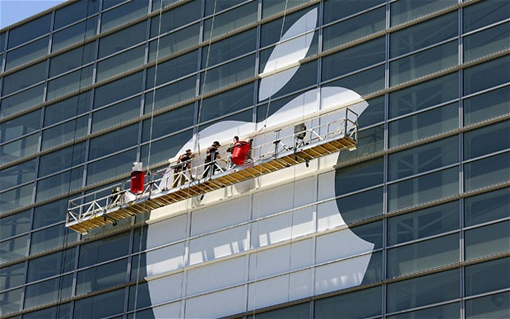
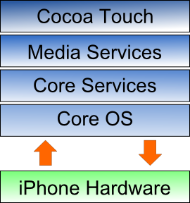
Operating System: iOS 2
iOS contains four abstractions layers, each of which provides programming frameworks for the development of applications that run on top of the underlying hardware.
iOS is derived from Mac OS X that shares with the Darwin foundation; and therefore, it is a Unix operating system.
Primary Apple development language is Objective-C; although, it is possible, with some translation work, to port Java code into iPhone.
http://www.techotopia.com/index.php/The_iOS_4_Architecture_and_SDK_Frameworks
http://iosframeworks.com/

Slide 39

iOS: Core OS layer 3
Compression
Ports
Exception Handler
Block Interpreter
Data types
Network Protocols
Sandboxes
Block Translator
Native Functions
Memory Manager
The Core OS Layer sits directly on top of the device hardware.
The layer provides a variety of services including low level networking, access to external accessories and the usual fundamental operating system services such as memory management, file system handling and threads.

Slide 40
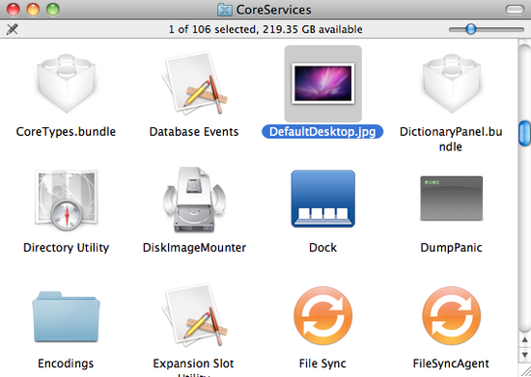
iOS: Core Services 4
The iOS 4 Core Services layer, built on the previous, Core OS, provides the foundation for the bundle of the frameworks:
1 Address Book framework
2 CF Network Framework
3 Core Data Framework
4 Core Foundation Framework
5 Core Media Framework
6 Core Telephony Framework
7 EventKit Framework
8 Foundation Framework
9 Core Location Framework
10 Mobile Core Services Framework
11 Store Kit Framework
12 SQLite library
13 System Configuration Framework
14 Quick Look Framework

Slide 41

iOS: Media 5
1 iOS Graphics and Video Support
1.1 Core Video Framework
1.2 Core Text Framework
1.3 Image I/O Framework
1.4 Assets Library Framework
1.5 Core Graphics Framework
1.6 Quartz Core Framework
1.7 OpenGL ES framework
2 iOS Audio Support
2.1 AV Foundation framework
2.2 Core Audio Framework
2.3 Open Audio Library (OpenAL)
2.4 Media Player framework
2.5 Core Midi Framework
The role of the Media layer is to provide iOS with audio, video, animation and graphics capabilities.
As the others layers that composed the iOS stack, the Media layer consist a number of frameworks that may be utilized when developing iPhone apps.

Slide 42
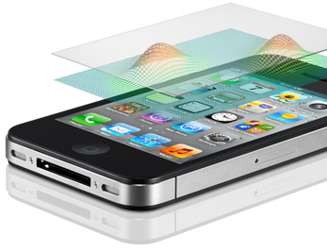

iOS: Cocoa Touch 6
The Cocoa Touch layer sits at the top of the iOS stack and contains the frameworks that are most commonly used by iPhone application developers.
Cocoa Touch is primarily written in Objective-C, is based on the standard Mac OS X Cocoa API (as found on Apple desktop and laptop computers) and has been extended and modified to meet the needs of mobile technology.
The Cocoa Touch layer provides the following frameworks for iPhone app development:
1 UIKit Framework
2 Map Kit Framework
3 Push Notification Service
4 Message UI Framework
5 Address Book UI Framework
6 Game Kit Framework
7 iAd Framework
8 Event Kit UI Framework

Slide 43
iOS Version’s History – NEED to KNOW 7
Apple's iOS did not have an official name until the release of the iPhone software development kit (iPhone SDK) on March 6, 2008.
When introduced, it was named iPhone OS. It was renamed to iOS in June 2010, after iPhone was no longer the only device to run iOS.
Version | First Release | Originally create/highest upgrade
3.1.3 | February, 2010 | iPhone (original); iPod Touch (1st generation)
4.2.1 | November, 2010 | iPhone 3G; iPod Touch (2nd generation)
5.0 | October, 2011 | iPhone 4S
5.1 | March, 2012 | iPad (3rd generation)
5.1.1 | May, 2012 | iPod Touch (4th generation); iPhone 4S
 | June, 2012 | Apple TV (3rd generation)
6.0 In Progress | June 25, 2012 Beta Version October 2012 | UPGRADE FOR: iPhone 3GS, iPhone 4, iPhone 4S, iPod Touch 4, iPad 2, iPad 3; Apple TV 3
http://en.wikipedia.org/wiki/IOS_version_history

Slide 44
List of Interview Questions: Section 1
1. What mobile platforms you are familiar with?
2. What do you know about Android OS?
3. What is a most common Android Version?
4. A/B What are the latest Android/iOS versions?
5. A/B What are the extensions of Android/iOS applications?
6. A/B What Android/iOS Browsers do you know?
7. A/B What Android/iOS developing Tools do you know?
8. A/B What Android/iOS Testing Tools do you know?
9. What do you know about SDK?
10. What do you know about iOS?
11. Describe Android OS vs. iOS
12. Describe Android vs. iPhone devices

Slide 45


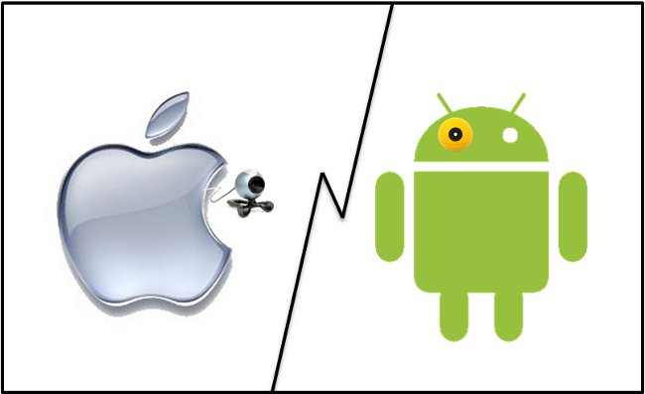
11. Describe Android OS vs. iOS 1
Source
Security
Platform
OS Architecture
Carriers
Life Battery
iOS
Web Browsers
ANDROID

Slide 46
Comparison Table: Android vs. iOS 2
Category | Google Android | Apple iOS
License | Open Source | Close - Proprietary
Company | Open Handset Alliance/Google | Apple
OS Platform | Linux | OS X – Unix (Darwin)
Programming Language | Java | Objective-C
Virtual Machine | Dalvik VM | None
Package Manager | APK | iTunes
Carriers | AT&T, Verizon, T-Mobile, Sprint, MetroPCS, Virgin, 88% out of 180 US carriers | Apple Store, AT&T, Verizon, Sprint, Alaska Communications, + another 6 carriers
Life Battery | Moderate | Advance high
Browser Engine | WebKit: Fennec, Opera Mini 7, Dolphin, Chrome | WebKit: Safari, Opera Mini 7, Atomic Web, Chrome

Slide 47



12. Describe Android vs. iPhone devices 1
User Interface
Users Controls
Application Store
Hardware
OS Openness
Hardware & OS lifecycle
Features & Services
iPhone
Android

Slide 48
Comparison Android vs. iPhone 2
Category | ANDROID | iPHONE | Winner
User Interface | Java Application Framework Customatization | Cocoa Touch BeginnerUser friendly
Navigation/User Controls | Widgets | Classic Touch | Android
Application Store | PlayStore 500,000 Apps | AppStore (iStore – iOS 6) 650,000 Apps | Apple
Hardware | Diversity create hard/software compatibility problems | Compatible among Apple product | Apple
OS openness | Freedom in managing apps and phone parts | Control and warranty limits over apps and phone parts | Android
Hardware & OS lifecycle | Variety of Makers on an “as-I-feel-like-it” basis, low-upgradable OS | Consistency in new iPhone forthcoming every year, high-upgradable OS | Apple

Slide 49
Features Comparison Android vs. iPhone 3
Features | Android | iPhone | Winner
WorldPhone | Both GSM and CDMA radios | Both GSM & CDMA networks, GLONASS (Russian GPS System) and Siri (natural language voice control system) automated voice assistant | Apple
Voice Commands | Voice Actions (2.2) Better voice-guided set | Siri (4S) Better social implementation | 50/50
Camera | Panoramic view, Buddy Photo Share, Burst Mode, Face Zoom | Ability to crop and rotate images, red-eye reduction, auto enhancement, and grid lines - solid basic | Android
Notifications | Badges and notification alerts, system-wide notifications, Widgets, | Badges and notification alerts, Notifications center, banner-style alerts | 50/50
http://www.youtube.com/watch?v=2OSjyjjJkvM
http://www.msnbc.msn.com/id/38382217/ns/technology_and_science-wireless/t/app-showdown-android-vs-iphone/

Slide 50
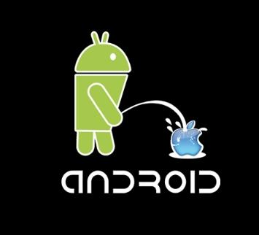
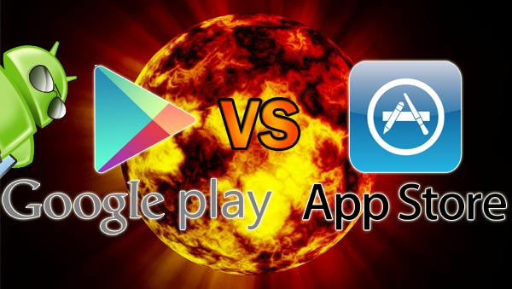
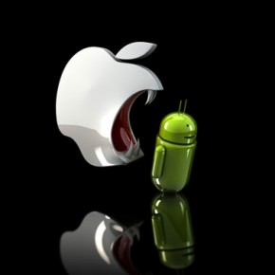
Features Comparison Android vs. iPhone 4
Features | Android | iPhone | Winner
Internet Browsing | Chrome bookmarks sync, Save of the full Web-page for later browsing, an incognito mode - interactive | Tabbed browsing for the iPad and iPad 2, private browsing, Safari Reader and Reading List - solid | Android
Cloud Storage | Apps, music, photos – free service | iTunes Match, Photo Stream, iWork, iLife - $25/year fee | 50/50
Extra Features | Face Unlock, People app, integrated screenshot, | Newsstand, integrated Twitter, Reminders app, Find My iPhone, AirPlay (with Apple TV), AirPrint | 50/50

Slide 51
TO be continue: NEXT TIME
1. What phone do you use right now?
2. What devices do you use for testing?
3. What Android devices do you used for Testing?
4. A/B How familiar you are with Apple/Android devices?
5. Do you know how to use iPhone?
6. How do you know what a current Mobile Device version is?
7. Tell me about different uses of HOME button on iPhone
8. How to see and kill the last process on iPhone?
9. A/B Show me how to activate “Flight” Mode on Android/iPhone
10. Do you know how to go through Android?
11. Smartphone vs. Feature phone
12. What is the about Smartphone that change everything?
13. Understand Mobile Application Structure – 6 questions
19 Questions

Slide 52

THANK YOU, Folks, for listening…

